Slide 1
DESKTOP VIRTUAL ASSISTANT
AKSHARA SHREEJHA K K
INDIRA GANDHI B
REVATHY SRI S
JOTHIKA M S
GUIDE: DR. E. SIVA SANKARI

Slide 2
PROBLEM STATEMENT
Develop an Intelligent system for Desktop service which listens to the user voice input and react to spoken user command, retrieve information from the internet and integrate with applications without using traditional input devices such as keyboard and mouse.

Slide 3
OBJECTIVES
Virtual Assistant system should be able to accurately understand and interpret user commands when expressed in natural language.
Perform various voice controlled tasks such as open/close application, searching the web, controlling media playback, manage alarm and remainders.

Slide 4
EXISTING SYSTEM
The process is done in manual mode by typing each and every word.
May not integrate seamlessly with all third-party apps and services.
Passes the queries to their respective search engines instead of performing it.
Time Consuming.

Slide 5
PROPOSED SYSTEM
Doesn't require devices like mouse and keyboard to provide input.
Features supported in the current version include interacting with the OS.
Easy to access files.
Integrates with third-party apps and services.

Slide 6
WORKFLOW

Slide 7
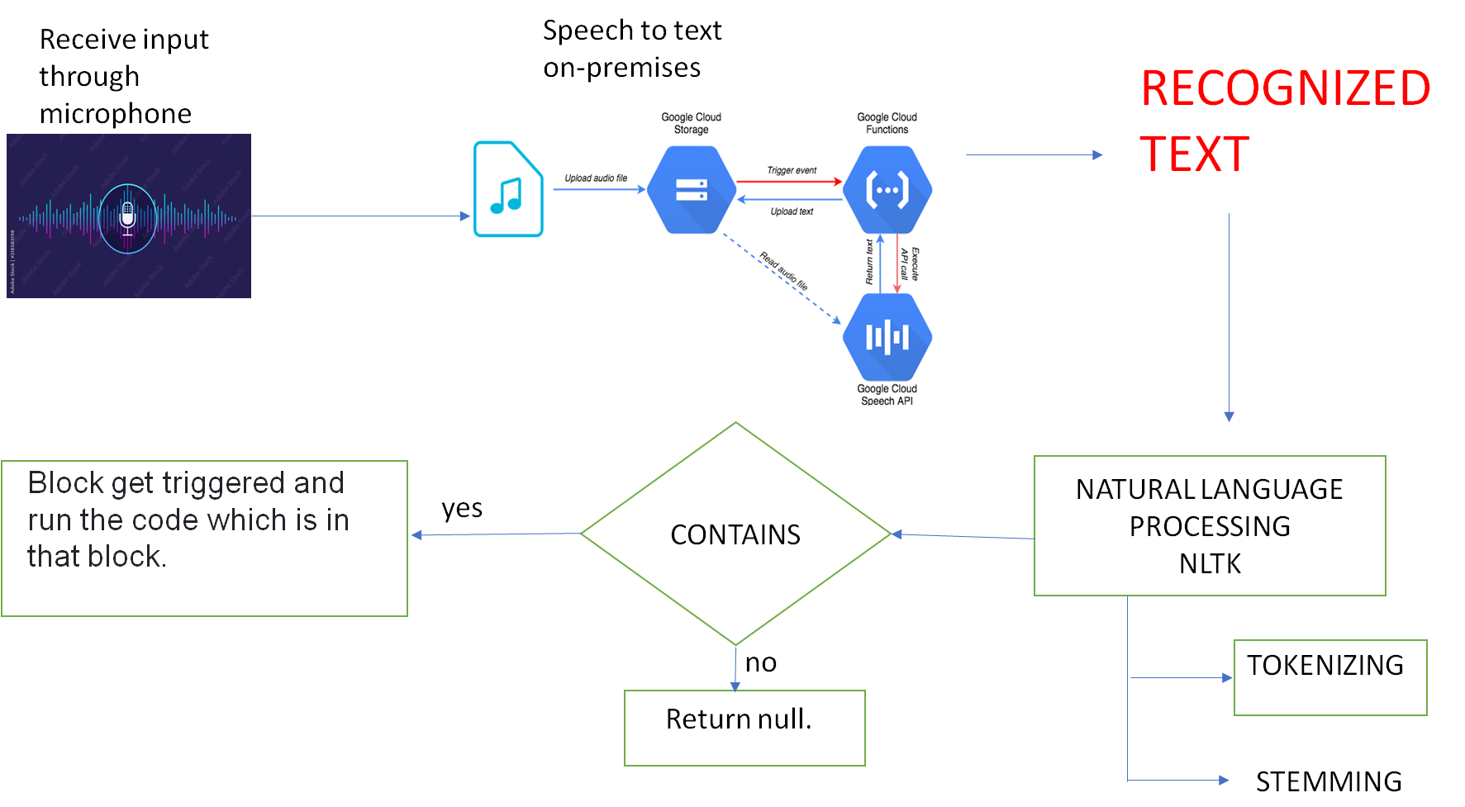

Slide 8
NATURAL LANGUAGE PROCESSING
Natural language Processing which is a subfield of Artificial Intelligence (AI) that focuses on enabling computers to interact and understand the Human language.
NLTK - Natural language Tool Kit is a popular open-source platform for building Python programs that work with human language data.
Tokenization
Import the “word_tokenize” from the “nltk.tokenize”.
Breaking text or speech data into individual words, phrases.
Stemming
Import PortStemmer from the nltk.stem
Apply the stemmer to each word in the text to obtain the root form.

Slide 9
MAIN PACKAGES REQUIRED
Specch Recognition
Google Speech Recognition is a technology developed by Google that allows computers to convert spoken language into written text.
Nltk
It is a really powerful tool to preprocess text data for further analysis
pyttsx3
pyttsx3 is a text-to-speech conversion library in Python.

Slide 10
FUNCTIONS OF VAS

Slide 11
Chrome Automation Functions
Webbrowser
A web browser module allows the voice assistant to search and interact with web content.
Os module
Python OS module provides the facility to establish the interaction between the user and the operating system.
Pyautogui
The pyautogui module in Python provides cross-platform and simulate mouse movements and clicks keyboard input.

Slide 12
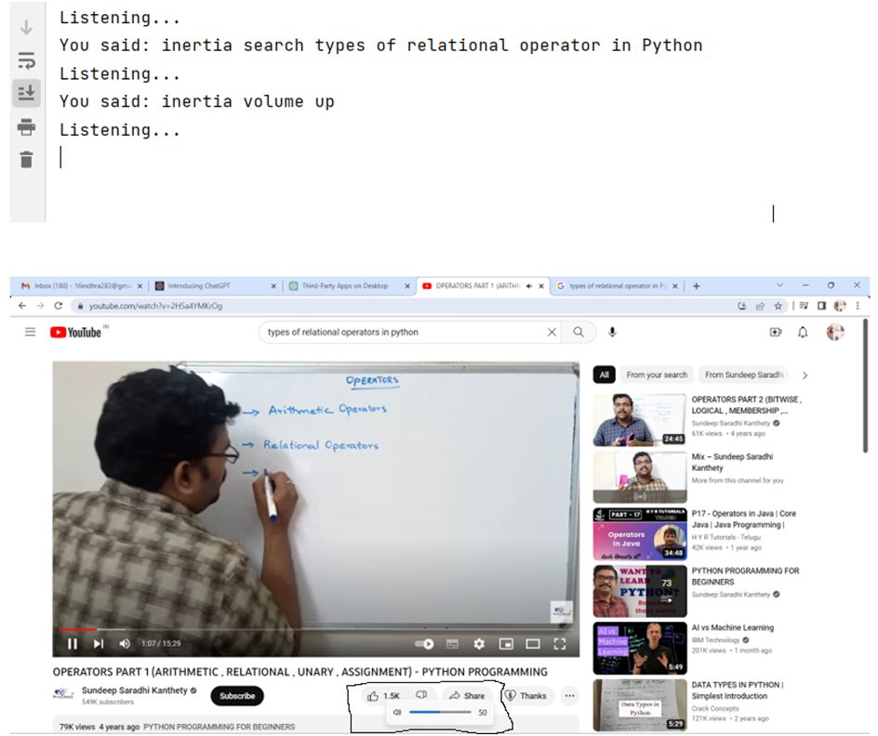
RESULT

Slide 13
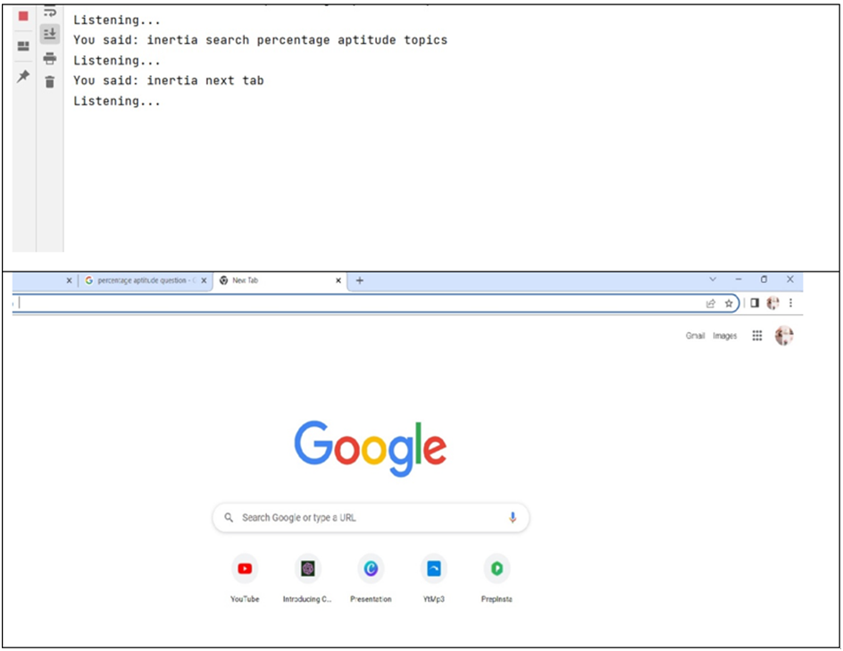

Slide 14
OS Functions
Empty Recycle Bin - Winshell
Perform various operations related to os, file system operations, and other Windows Shell functionalities.
Perform functions like getting the files in the recycle bin, emptying it, or restoring file
Background Change - ctypes, random
ctypes gives access to windows components such as the screensaver and wallpaper.
ctypes.windll.user32.SystemParametersInfoW(20,0, randomImg, 0)

Slide 15
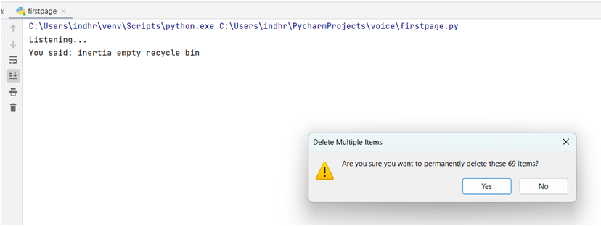
RESULT

Slide 16
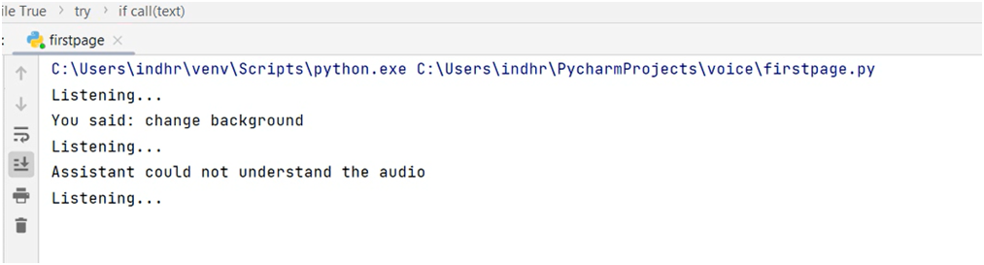
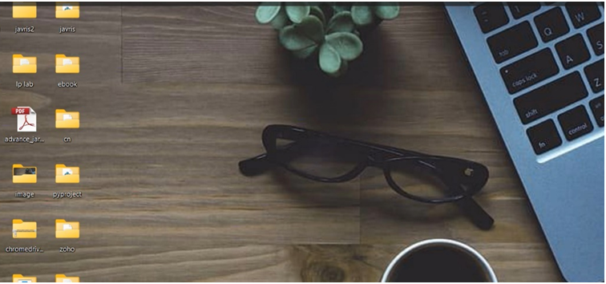
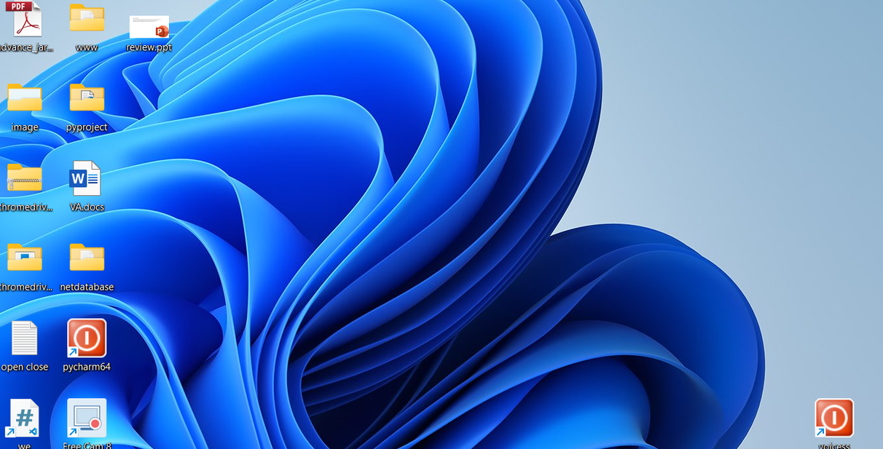

Slide 17
Remainder, Alarm - datetime
The datetime module is a standard Python module that offers functions for accessing and converting time.
Make a Note - subprocess
The subprocess module present in Python is used to run new applications or programs through Python code by creating new processes.
General Questions,Calculation - wolframalpha
Wolfram Alpha is an computational knowledge engine and perform various computations, queries interact with Wolfram Alpha's API

Slide 18
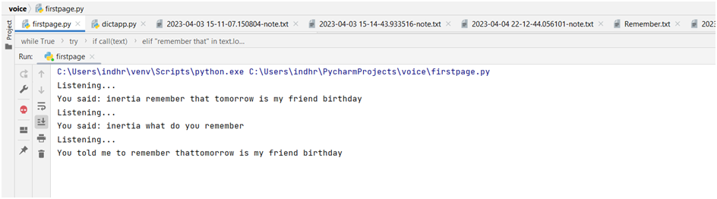
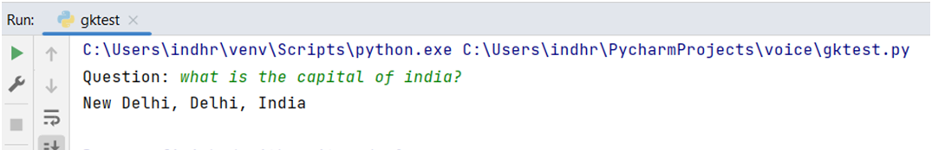
RESULT

Slide 19
Location - webbrowser,GoogleMapAPI
Make a request to the Google Maps Geocoding API and retrieve the corresponding geolocation data through web browser.
Access Media Player - playsound
It is a cross-platform library used to play sound files in various formats, such as WAV, MP3, and others.
News- json, requests
json is often used in web APIs to transfer data between a server and a client application.
requests can be utilized to fetch news data from various APIs

Slide 20
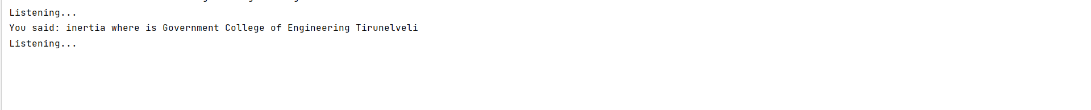
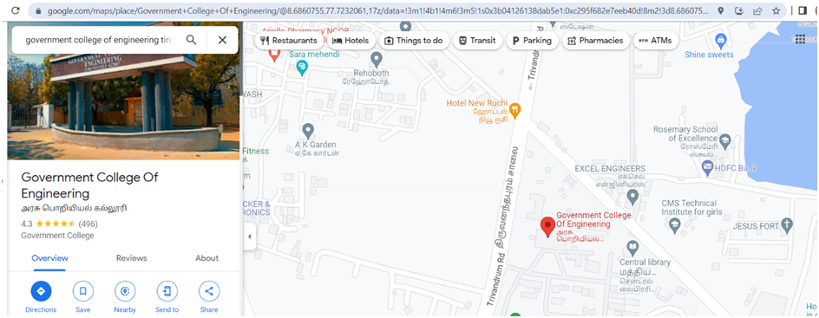

Slide 21
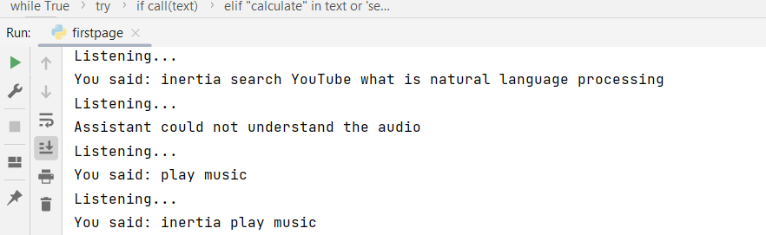
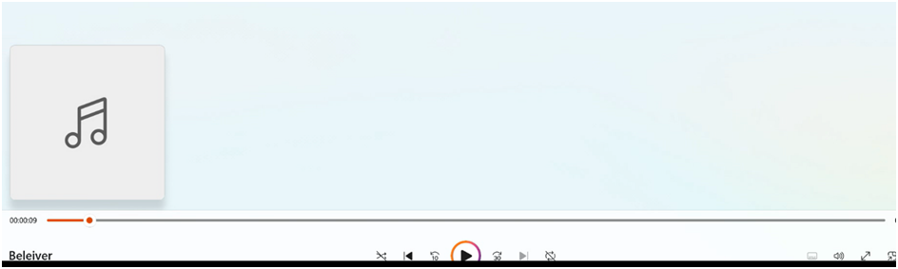
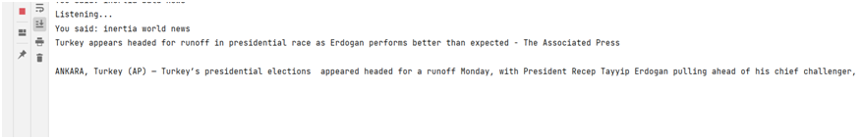

Slide 22
OPEN/CLOSE
Built-in software
File explorer, Media player, CMD, Image editor-paint,
Text editor-notepad
os module - open
os module is used to launch the built-in application on a operating system.
"WINDIR" environment variable, which represents the location of the directory on the system.
os.startfile() method is used to execute the app.exe file.
os.system() command forces the application process to close.

Slide 23
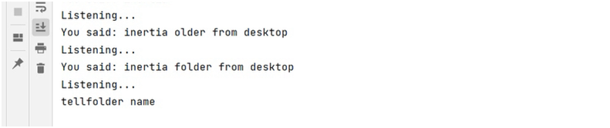
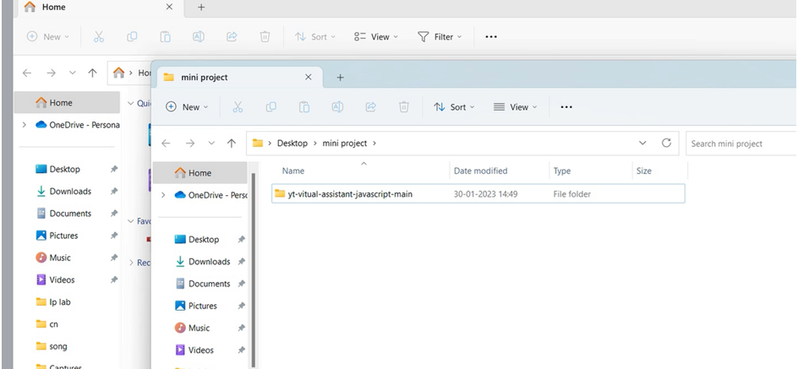

Slide 24
Application Software
pyautogui:Open
pyautogui.press("enter") line simulates pressing the Enter key on the keyboard to launch the application.
os module:Close
The os.system() command is used to run a system command within a Python script.
The command is taskkill/f/im/APP.exe, that forces the application process to close.

Slide 25
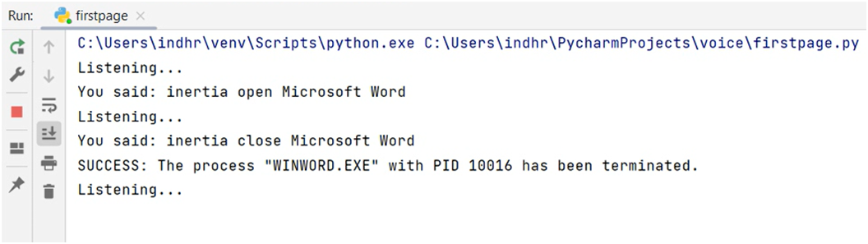
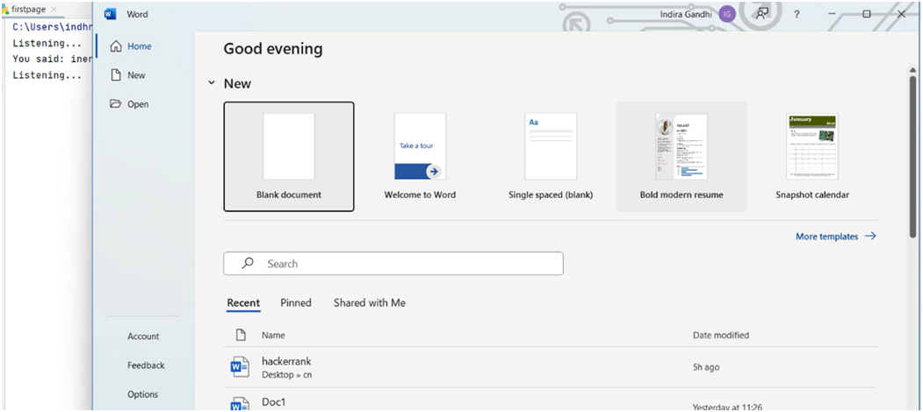

Slide 26
Notepad Typing
pyautogui.typewrite()
It is used to simulate keyboard typing and types the given text onto the active window
The program continuously listens for voice input, converts it to text, and then types the text using the type_text() function.

Slide 27
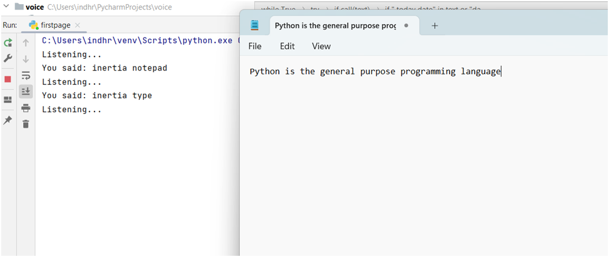
RESULT

Slide 28
CONCLUSION
Overall, virtual assistant systems have the potential to greatly enhance productivity and simplify daily life for users.
As technology continues to advance, it is likely that these systems will become even more sophisticated and capable of handling complex tasks.

Slide 29
THANK YOU

